Slide 1


Anomaly Detection in Test Fields
Sandipan Roy, Margaret Duff, Lizhi Zhang, Clarice Poon, Matthew Nunes, Georg Seewald (AVL), Corinna Kindhofer (AVL)
ITT10, June 2019

Slide 2





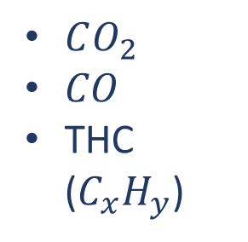
$CO_{2}$
$CO$
THC ($C_{x}H_{y}$)
Anomaly Detection in Test Fields | ITT10 | June 2019

Slide 3
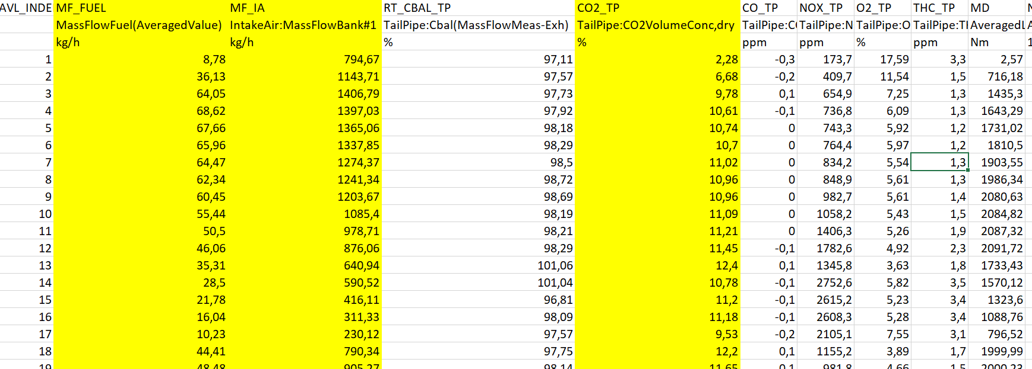
The Data
11 examples – 5 with problems , 6 without
180 control points for each sample
3 main measures and some more information
Anomaly Detection in Test Fields | ITT10 | June 2019

Slide 4
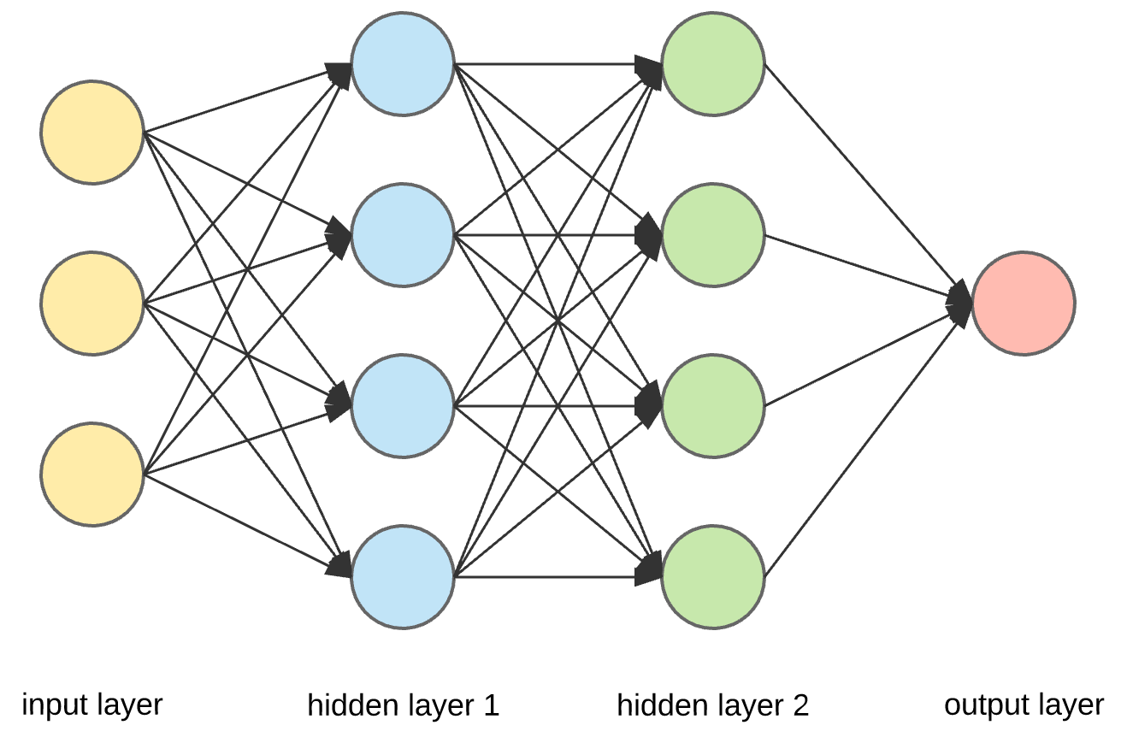
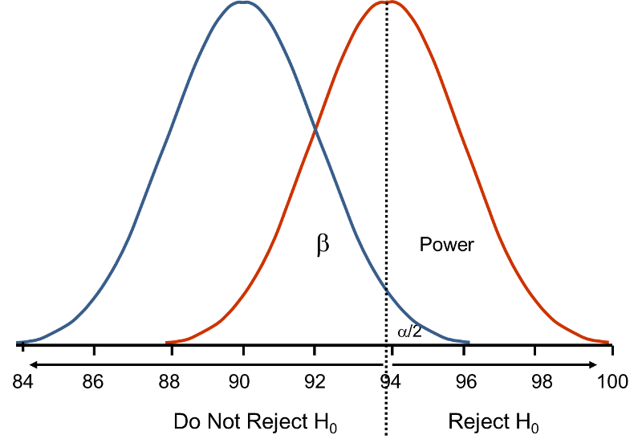
The Master Plan (for now)
Inverting formula
  Given data from 2 sensors and assuming a perfect ratio of air intake and output , recreate the data from the third sensor
2. With labelled data train classifiers
  E.g. Logistic regression, neural networks
  Data augmentation if needed
3. Looking for changes in distribution – Gaussian Mixture
  Treat results as sampling from some unknown distribution
  Look for evidence of changes in distribution
Anomaly Detection in Test Fields | ITT10 | June 2019

